Slide 1
Coursera Capstone Project
Victoria, Australia vs. Toronto, Canada
By Sabriena Tancsics

Slide 2
CONTENTS
Overview/ Introduction
Assessment Requirements
Topic of choice
Methodology
Toronto, Canada Data
Results
Location
Neighbourhood Safety
Python Scripts
Methodology
Victoria, Australia Data
Results
Python Scripts
Methodology
Conclusion

Slide 3
Overview/ instruction
The Data Science Capstone Project by IBM is to demonstrate Python and Critical Thinking skills when analyzing datasets. Several units in the Data Science course provides comprehensive tools and resources on how to extract data using API’s, manipulate data and use visualization tools to present findings.
This PowerPoint reviews data from Toronto Canada, comparing it to Victoria Australia data. Data resources is from google, wiki and more.
Data/coding is recorded on GITHUB but snapshots of scripts are supplied in this PowerPoint to help provide an idea of what I did to get to m results.

Slide 4
TOPIC OF CHOICE
My assessment will cover multiple areas in analyzing the data across the Neighborhoods of Toronto, Canada and Victoria, Australia. The objective of this task is to dig deep onto what location is safer, and best choice of residence, analyzing and pulling data from applications like foursquare, Wikipedia and other potential other websites for validation.
Situation: I've received a job offer to a new company on the other side of the world, Toronto, Canada. This role comes with great career prospects, opportunities and a pay increase to big to not consider. Before transition and acceptance, I need to assess the location I want to move, safety of its neighborhood, and more to come to my decision.
Background: I live by the beaches of Melbourne, Australia, where the neighborhood is quiet, safe, has great amenities, cafes, parks and more. Pharmacies are nearby, schools, overall a great place to raise children. Given the distance between the offer and current residence, I would either need to decline the offer or move abroad.
Objective: To relocate I need to find a similar neighborhood with much to offer.
Current assessments have been completed about Toronto through Week3 this of this lab, looking at postal codes, analyzing clusters in and around Toronto and comparing it to Melbourne. This assessment will be a continuation, looking into more innovative ways to assess viability and creativity of analysis skills acquired throughout the data science course.

Slide 5
METHODOLOGY
To analyze the neighborhoods, I will use the following data sources;
Pulling data from Toronto neighborhoods using the following Wikipedia page, https://en.wikipedia.org/wiki/List_of_postal_codes_of_Canada:_M,
Using the foursquare web application to access locations, tips, and options in particular neighborhoods https://foursquare.com/
Using online resources to understand safety within the top-rated neighborhoods
there is a crime map available on https://data.torontopolice.on.ca/pages/maps
Additional data may be used throughout to help validate research.
Useability: To use this data, I will be conducting the following activities;
Pulling data from an API extract within Python
Clean data to narrow specific demographics
Wrangle data to fit into graphs and charts for better analysis
Create dataframes to store new data that cannot be pulled from online sources
Rate data on importance
Once I have a complete dataset, I will analyze and decide if I shall move or not move. Weighing out the pros/cons in a statistical and analytical manner.

Slide 6
TOOLS USED
Tools used found on my GITHUB respitory
Folium library, including choropleth map, heatmap in map view
Google Geocoding APIs
Foursquare APIs
Horizontal Bar Chart
Pandas, Numpy, SkiLearn

Slide 7
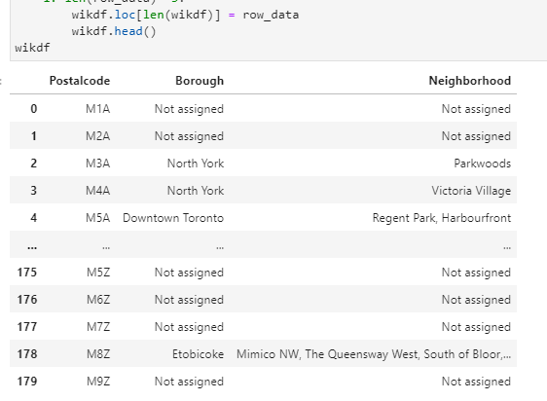
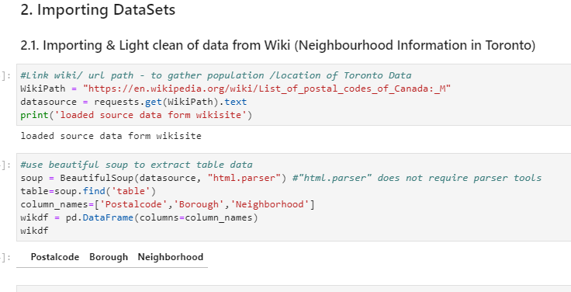
TORONTO DATA: wiki data SCRIPTS
To analyze data, I needed to pull data from wiki and use beautiful soup to help extract table data. Each extraction required manipulation and wrangling to extract a subset of the data.

Slide 8
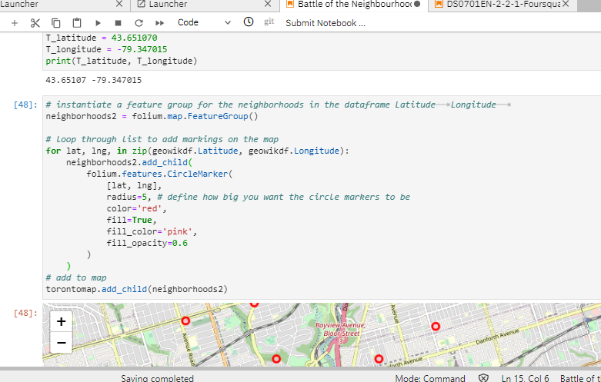
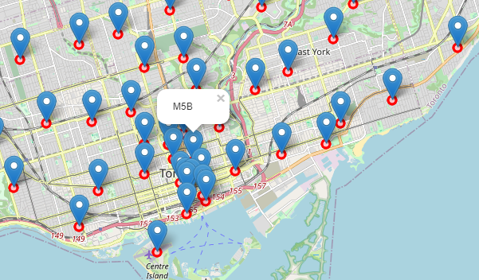
TORONTO DATA: GEO MAPPING
As there is over a hundred neighborhoods in Toronto, we can place all these neighborhoods on a map an assess a desirable location. This will be helpful when looking at crime statistics.

Slide 9
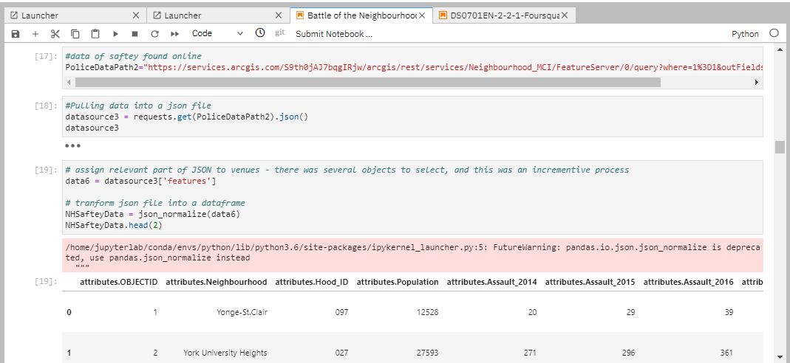
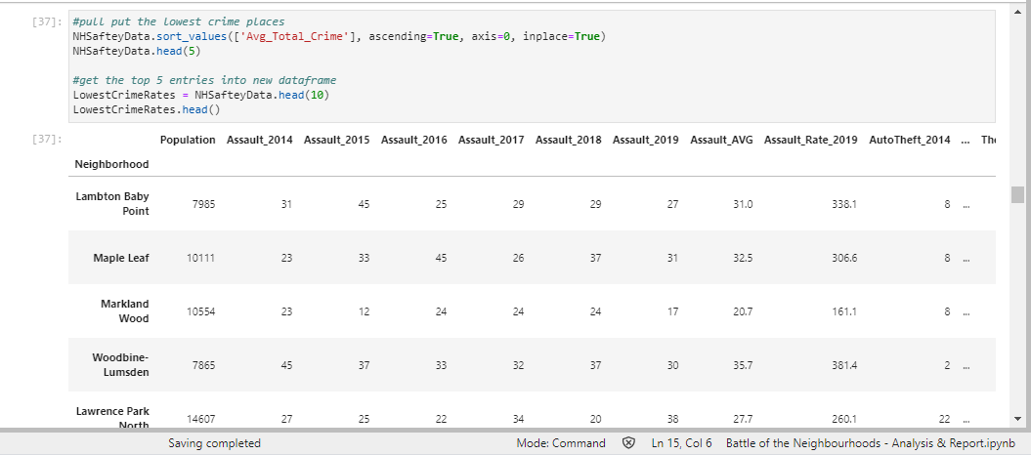
TORONTO DATA: NEIGHBORHOD SAFETY
After a map is setup, then we can refine the list to only show locations with high-low crime. This will help assess the best neighborhood to live in. Below is a snapshot of how I can pull crime data online and pull it into Jupiter notebooks.

Slide 10
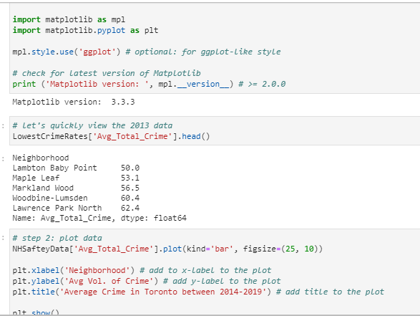
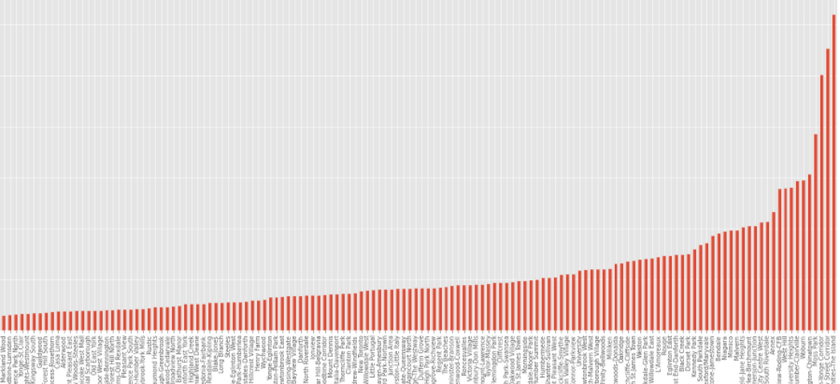
TORONTO DATA: crime rates
As shown below, some neighborhoods face much higher crime rates than others which can be removed from our list. To refine, we can view the lowest and highest crime in Toronto.

Slide 11
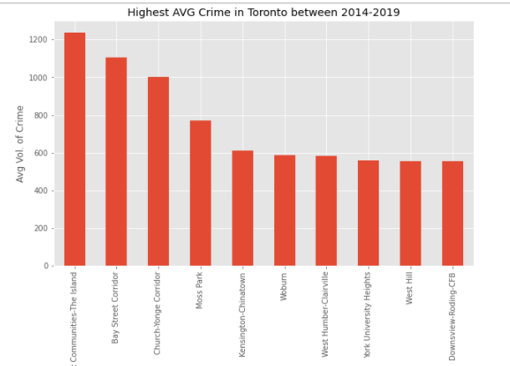
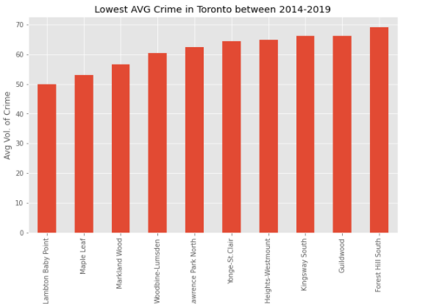
TORONTO DATA: Crime rates top 10
Using matplolib, we can ascend or descend our data, use head to select the top 10 and create separate the data frame. With this, we can then populate this data into our Toronto map to then find the desirable location.

Slide 12
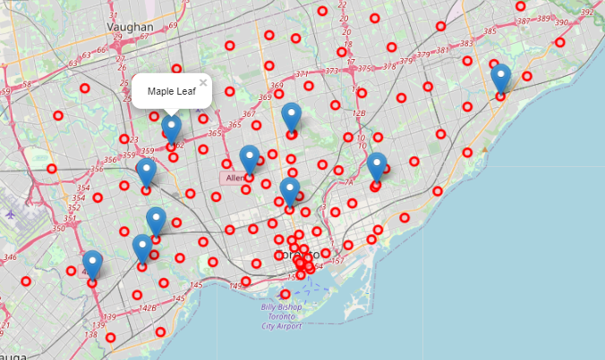
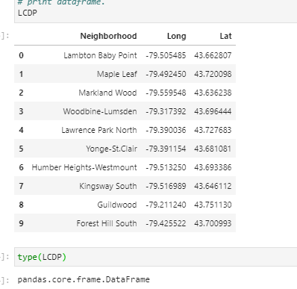
TORONTO DATA: Safest neighbors
The red dots represent all the neighborhoods in Toronto, the blue pins are the lowest crime rated neighborhoods. Here we will analyze Maple Lead and Lampton Baby Point.

Slide 13
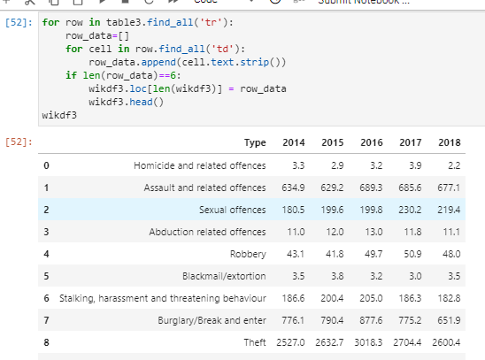
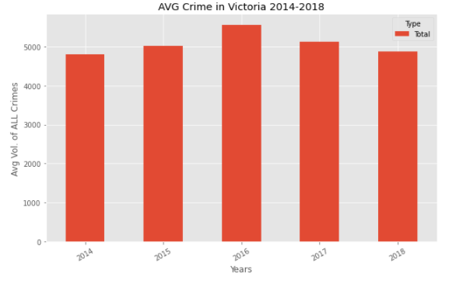
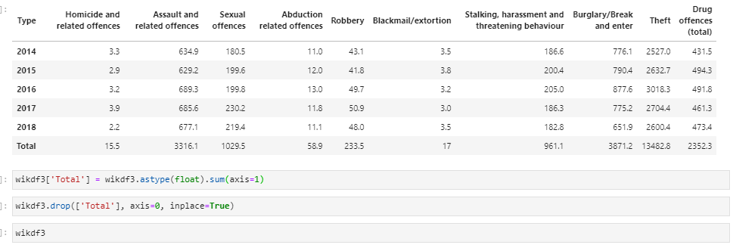
VICTORIA DATA: CRIME & SAFTEY
As we are to compare Victoria, Australia crime to Toronto, Canada, I pulled data from wiki, cleaned up the dataset to pull the same column information at Toronto's to compare.

Slide 14
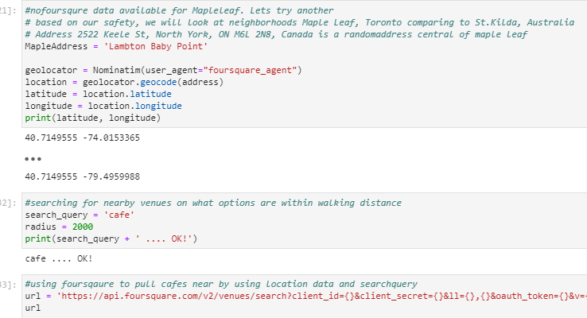
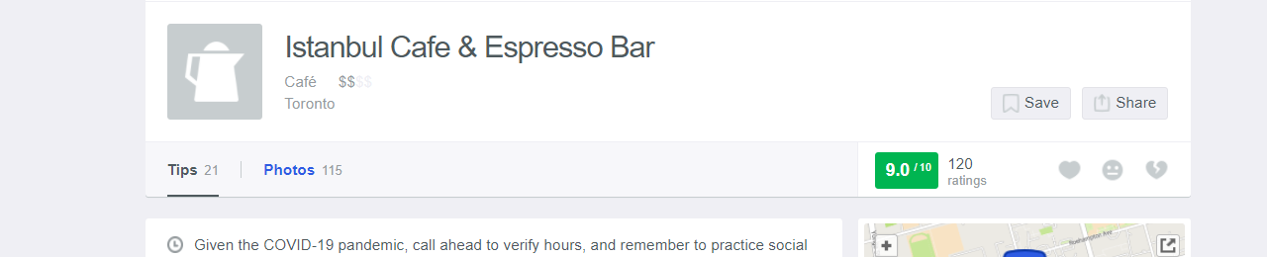
FOURSQAURE: MELBOURNE VS TORONTO
Next, I need to establish if I would have a nice cafés nearby. As a flexi worker, I need to assess how well rated cafes are and the average costs for coffee.
Maple Leaf and Lampton had minimal options or cafes compared to Melbourne. To assess I used a foursquare API to look for café’s nearby. I was only able to get information on Instabul Café. Four square had limited information on Australia as well. Thus making foursquare not a reliable source for insight.

Slide 15
CONCLUSION
Based on crime data and cafes in the area, Australia is the preferred choice.
Recommendations would be to look at other booking services like open table.

